Slide 1
Machine Learning

Slide 2
What is Machine Learning
Machine learning - term coined around 1960.
Composed of two words—
machine corresponds to a computer, robot, or other device,
learning refers to an activity intended to acquire or discover event patterns, which we humans are good at.

Slide 3
Want Machines to Learn!!!?
Computers and robots can work 24/7, need very low maintenance and don't get tired, need breaks, call in sick, or go on strike.
Their performance is justifiable for sophisticated problems that involve a variety of huge datasets or complex calculations.
Machines driven by algorithms designed by humans are able to learn latent rules and inherent patterns and to fulfill tasks desired by humans.
Learning machines are better suited than humans for tasks that are routine, repetitive, or tedious.

Slide 4
Evolution of Machine Learning
Manually defining, maintaining, and updating rules becomes more and more expensive over time.
Extracting the number of possible patterns for an activity or event (dynamic, real-time) is not practically feasible and would exhaust all enumeration.
It is much easier and more efficient to develop learning rules or algorithms which command computers to learn and extract patterns, and to figure things out themselves from abundant data.

Slide 5
Emerging School of Thought
Active learning or human-in-the-loop – advocates combining the efforts of machine learners and humans.
The idea is routine boring tasks are more suitable for computers, and creative tasks more suitable for humans.
According to this philosophy, machines are able to learn, by following rules (or algorithms) designed by humans and to do repetitive and logic tasks desired by a human.

Slide 6
Overview of Machine Learning
Machine learning mimicking human intelligence is a subfield of artificial intelligence.
It’s closely related to linear algebra, probability theory, statistics, and mathematical optimization.
Machine learning models are built based on statistics, probability theory and linear algebra, then optimize the models using mathematical optimization.

Slide 7
Overview of Machine Learning
Machine learning definition :-
A computer program is said to learn from experience E with respect to some class of tasks T and performance measure P, if its performance at tasks in T, as measured by P, improves with experience E.

Slide 8
Examples of Machine Learning
“Is this cancer?”, “What is the market value of this house?”, “Which of these people are good friends with each other?”, “Will this rocket engine explode on take off?”, “Will this person like this movie?”, “Who is this?”, “What did you say?”, and “How do you fly this thing?”
Playing computer games, recognize spoken words, drive autonomous vehicles, classify/recognize structures and so on.

Slide 9
Overview of Machine Learning
.
Input
Machine Learning Model
Output
Numeric, textual, audio, visual
Explore, construct algos that learn from historical data and perform on new data.
Prediction or Classification
Define Loss or Cost function to optimize the goal of learning

Slide 10
Categories of Machine Learning
Depending on the nature of learning data Machine Learning tasks can be classified as –
Supervised Learning
Unsupervised Learning
Reinforcement Learning

Slide 11
Supervised Learning
The general rule of the learning goal is to map input to output.
The learning data is labeled data – comes with description, targets or desired outputs along with indicative signals. The labels are usually provided by event logging systems and human experts.
The learned rule is then used to label new data with unknown outputs.
Used in daily applications, such as face and speech recognition, products or movie recommendations and sales forecasting.

Slide 12
Supervised Learning
We can further subdivide supervised learning into regression and classification.
Regression trains on and predicts a continuous-valued response, for example predicting house prices.
Classification attempts to find the appropriate class label, such as analyzing positive/negative sentiment and prediction loan defaults.

Slide 13
Unsupervised Learning
The learning goal is to understand the data, learn from it and then produce the results.
Learning data is unlabeled data – contains only indicative signals without any description attached. We need to find structure of the data underneath, to discover hidden information, or to determine how to describe the data.
Unsupervised learning can be used to detect anomalies, such as fraud or defective equipment, or to group customers with similar online behaviors for a marketing campaign.

Slide 14
Semi-supervised Learning
Learning data is partially labeled.
It makes use of unlabeled data (typically a large amount) for training, besides a small amount of labeled.
Applied in cases where it is expensive to acquire a fully labeled dataset while more practical to label a small subset.
For example, it often requires skilled experts to label hyperspectral remote sensing images, and lots of field experiments to locate oil at a particular location, while acquiring unlabeled data is relatively easy.

Slide 15
Reinforcement Learning
Learning data provides feedback so that the system adapts to dynamic conditions in order to achieve a certain goal.
The system evaluates its performance based on the feedback responses and reacts accordingly.
The best known instances include self-driving cars and chess master AlphaGo.

Slide 16
Machine Learning Algorithms
Logic-based learning
They used basic rules specified by human experts, and with these rules, systems tried to reason using formal logic, background knowledge, and hypotheses.
Statistical Learning
Artificial Neural Networks
They imitate animal brains, and consist of interconnected neurons that are also an imitation of biological neurons. They try to model complex relationships between inputs and outputs and to capture patterns in data.
Genetic Algorithms
They mimic the biological process of evolution and try to find the optimal solutions using methods such as mutation and crossover.

Slide 17
Data for Machine Learning
Good thing – we have a lot of data in the world.
Bad thing – hard to process this data.
Challenges – diversity and noisiness of the data.
We as humans, usually process data coming in our ears and eyes. These inputs are transformed into electrical or chemical signals.
Computers too can process electrical signals.

Slide 18
Data for Machine Learning
Data for ML is represented either as numbers, images, or text.
Images and text are not very convenient, so they need to be transformed into numerical values.

Slide 19
Training, Testing, Validation Data Sets
Training Data Set – Practice Questions
learn something from them and hopefully are able to apply this knowledge to other similar questions.
ML models derive patterns from these.
Testing Data Set – Actual Exams
Models are applied and test their compatibility.
Validation Data Set – Mock Test
To assess how well we will do in actual ones and to aid revision.
Verify how well the models will perform in a simulated setting then we fine-tune the models accordingly in order to achieve greater hits.

Slide 20
Data for Machine Learning
The model is given example input values and example output values. Or if we are more ambitious, we can feed the program the actual inputs and let the machine process the data further just like an autonomous car doesn't need a lot of human input.

Slide 21


Practice Questions
Question 1 -------- Ans is option A
Question 2 -------- Ans is option B
Question 3 -------- Ans is option A
Question 4 -------- Ans is option B
Question 5 -------- Ans is option A
Even if the question is not related to potatoes and tomatoes you may memorize the answers for each question verbatim.

Slide 22
Exam Questions
Question 1 -------- Option ???
Question 2 -------- Option B
Question 3 -------- Option???
Question 4 -------- Option ???
Question 5 -------- Option ???
We will score very low on the exam questions as it is rare that the exact same questions will occur in the actual exams.

Slide 23
Overfitting
The phenomenon of memorization can cause overfitting.
Over extracting too much information from the training sets and making the model just work well with them – low bias in machine learning.
This will not help us generalize with data and derive patterns from them.
The model as a result will perform poorly on datasets that were not seen before – high variance in machine learning.
This occurs when the learning rules are described based on a relatively small number of observations, instead of the underlying relationship.
Also when the model is made excessively complex so that it fits every training sample, such as memorizing the answers for all questions.

Slide 24
Underfitting
A model is underfit if it does not perform well on the training sets and will not so on the testing sets.
It fails to capture the underlying trend of the data.
This may occur if we are not using enough data to train the model. (like we will fail the exam if we did not review enough material).
Underfit will result if a wrong model is fit to the data. (like we will score low in any exercises or exams if we take the wrong approach and learn it the wrong way)
This is high bias in machine learning, although its variance is low as performance in training and test sets are pretty consistent, in a bad way.

Slide 25
Avoiding Overfitting & Underfitting
High bias results in underfitting (incorrect assumptions)
Variance measures how sensitive the model prediction is to variations in the datasets. High variance causes Overfitting.
Hence, try to always make both bias and variance as low as possible.
In practice, there is an explicit trade-off between themselves, where decreasing one increases the other. This is called bias–variance tradeoff.

Slide 26
Bias-Variance Tradeoff Example
We were asked to build a model to predict the probability of a candidate being the next president based on the phone poll data. The poll was conducted by zip codes. We randomly choose samples from one zip code, and from these, we estimate that there's a 61% chance the candidate will win. However, it turns out he loses the election. Where did our model go wrong? The first thing we think of is the small size of samples from only one zip code. It is the source of high bias, also because people in a geographic area tend to share similar demographics. However, it results in a low variance of estimates. So, can we fix it simply by using samples from a large number zip codes? Yes, but this might cause an increased variance of estimates at the same time. We need to find the optimal sample size, the best number of zip codes to achieve the lowest overall bias and variance.

Slide 27
Avoiding Overfitting with Cross-validation
Cross-validation data set – mock tests.
The validation procedure helps evaluate how the models will generalize to independent or unseen datasets in a simulated setting.
The original data is partitioned into three subsets, usually 60% for the training set, 20% for the validation set, and the rest 20% for the testing set.
This setting suffices if we have enough training samples after partition.

Slide 28
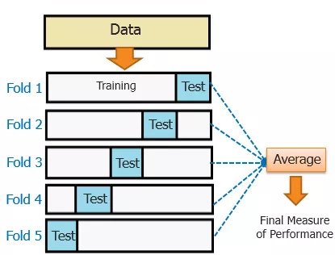
Cross-validation

Slide 29
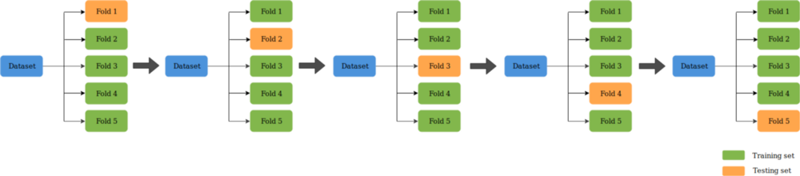
Cross-validation
Testing results from all rounds are averaged to generate a more accurate estimate of model prediction performance.
Cross-validation helps reduce variability and therefore limit problems like overfitting.

Slide 30
Cross-validation – Exhaustive scheme
Leave-one-out-cross-validation (LOOCV) – Leave out a fixed number of observations in each round as testing (or validation) samples, the remaining observations as training samples. This process is repeated until all possible different subsets of samples are used for testing once.
A dataset of size n, LOOCV requires n rounds of cross-validation.
This can be slow when n gets large.

Slide 31
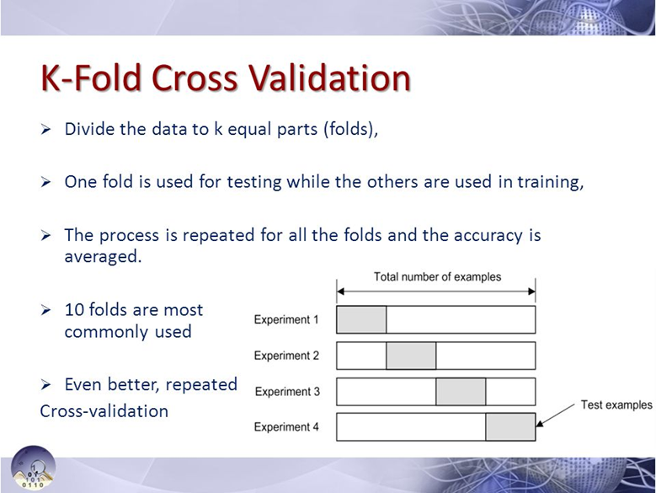
Cross-validation – Non-Exhaustive scheme
This does not try out all possible partitions. Most widely used type of this scheme is k-fold cross-validation.
Common values for k are 3, 5, and 10.
Average the k sets of test results for the purpose of evaluation.

Slide 32
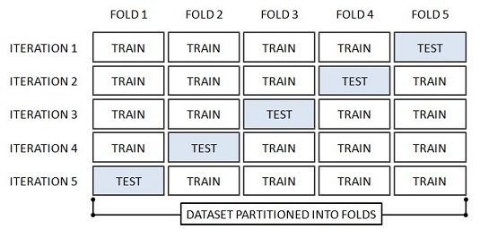
k-fold cross-validation

Slide 33
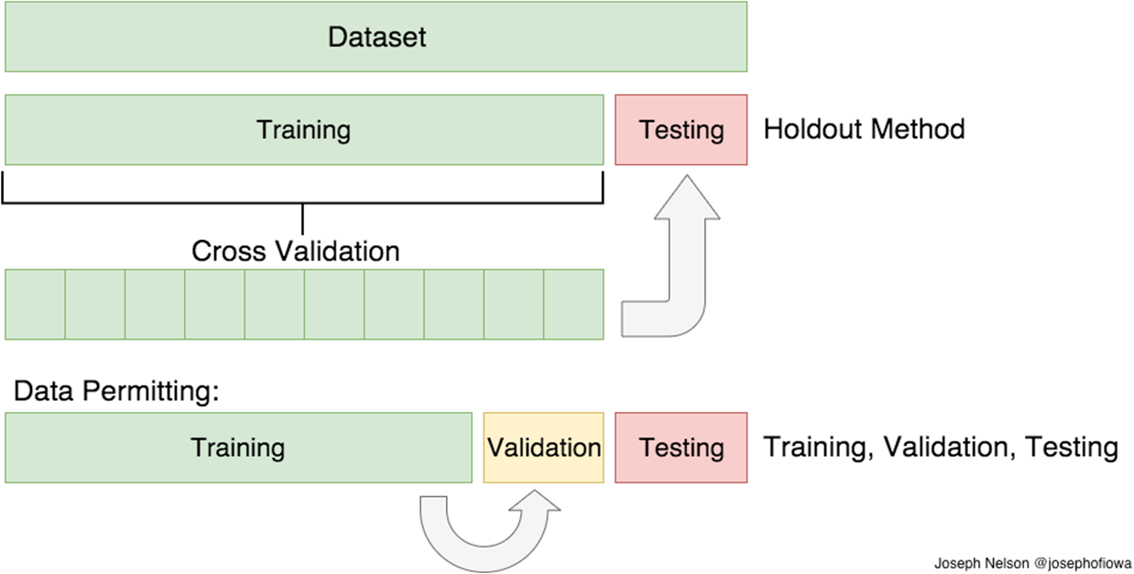
Cross-validation – Holdout Method
Randomly split the data into training and testing set numerous times.
Problem – some samples may never end up in the testing set, while some may be selected multiple times in the testing set.

Slide 34
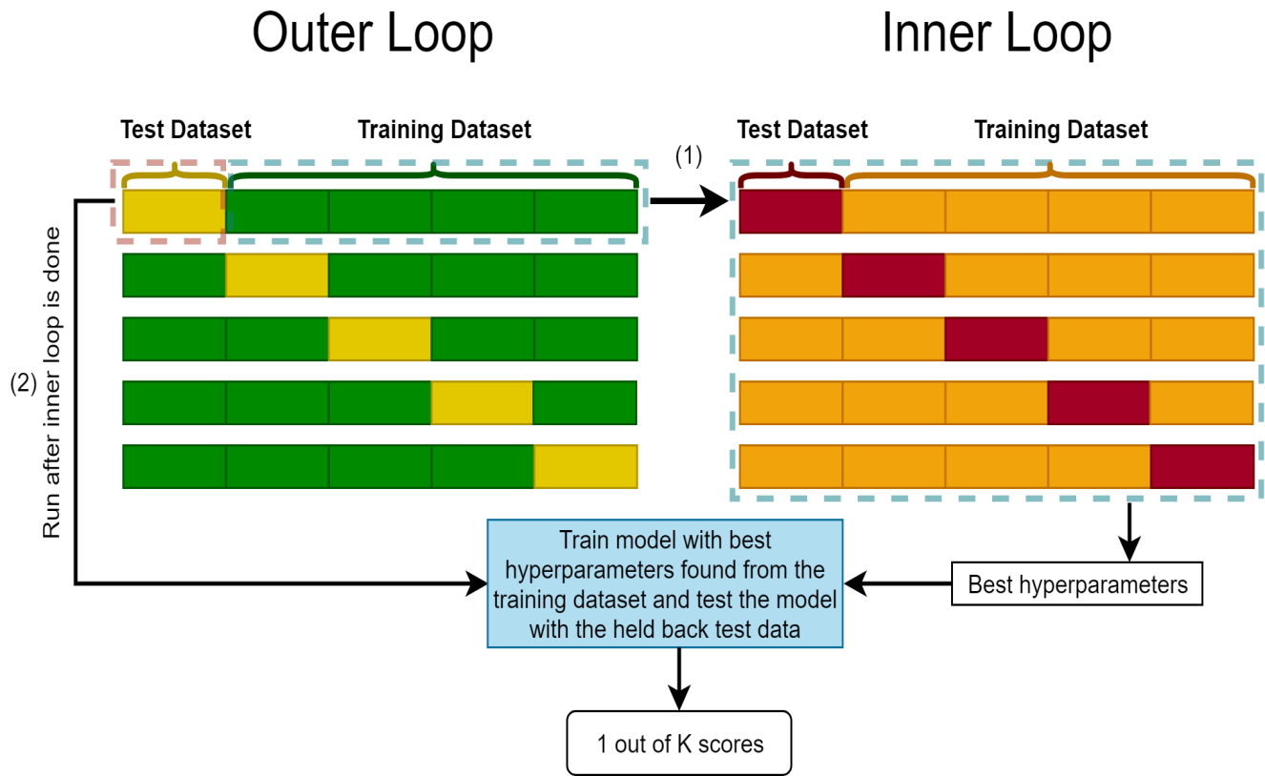
Nested Cross-validation
It is a combination of cross-validations. It consists of the following two phases:
The inner cross-validation, is conducted to find the best fit, usually implemented as a k-fold cross-validation.
The outer cross-validation, is used for performance evaluation & statistical analysis.

Slide 35
Analogy for Cross-validation
A data scientist plans to take his car to work, and his goal is to arrive before 9 am every day. He needs to decide the departure time and the route to take. He tries out different combinations of these two parameters on some Mondays, Tuesdays, and Wednesdays and records the arrival time for each trial. He then figures out the best schedule and applies it every day. However, it doesn’t work quite well as expected. It turns out the scheduling model is overfit with data points gathered in the first three days and may work well on Thursdays and Fridays. A better solution would be to test the best combination of parameters derived from Mondays to Wednesdays on Thursdays and Fridays and similarly repeat this process based on different sets of learning days and testing days of the week. This analogized cross-validation ensures the selected schedule work for the whole week.

Slide 36
Avoiding Overfitting with Regularization
Overfitting also occurs due to unnecessary complexity of the model.
Linear model (2 parameters) – span a 2-D space.
Quadratic polynomial (3 parameters) – span a 3-D space.
High order polynomial function (n parameters) – spans a much larger space.
Such models are easily obtained models.
But they generalize worse than linear models.
Hence are more prompt to overfitting.

Slide 37
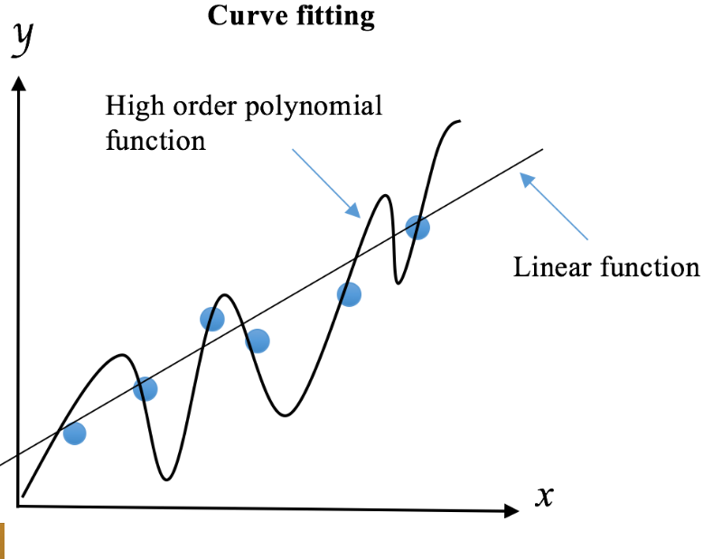
Linear Function Vs. Polynomial Function
So if we need easily-obtainable models then complexity has to be handled.
Regularization reduces the complexity by imposing penalties on high orders of polynomials.
But a less accurate and less strict rule is learned by the model during training phase.

Slide 38
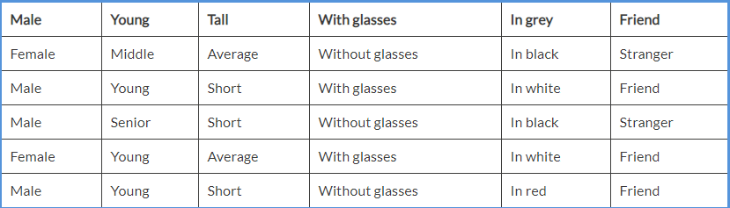
Regularization Example
Equip robotic guard dog the ability to identify strangers and friends.
The rules are too complicated and unlikely to generalize well to new visitors.
Regularization should be optimal because :
Too small regularization does not have any impact.
Too large regularization results in underfitting (model becomes complex, falls short of data).

Slide 39
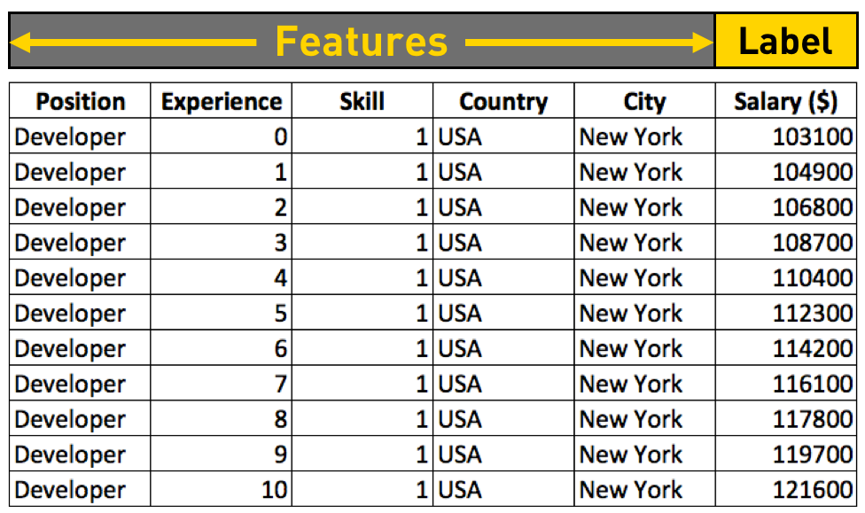
Feature Selection & Dimensionality Reduction
High dimensional data
computationally expensive
prone to overfitting due to high complexity.
impossible to visualize.
Not all the features are useful, and may add randomness to results.
For better model construction good feature selection is important.

Slide 40
Preprocessing, exploration and feature engineering
A machine learning system isn't able to recognize gibberish, so we need to help it by cleaning the input data.
Understand the data – First scan the data and/or second visualize the data.
A grid of numbers is the most convenient form to process.
Feature engineering is the process of creating or improving features.
They are often created based on common sense, domain knowledge, or prior experience.
Missing values – ignore them or try imputing (arithmetic mean, median or mode).
Encoding (Label encoding, On-hot encoding), Scaling, Polynomial features, Power transformations, Binning.

Slide 41
Why feature scaling?
Most of the ML models work on the Euclidean Distance.
Data won’t be on the same scale. Hence the distance between such data points can’t be calculated properly.
As a result ML models will have problems in learning this type of data.
Hence feature scaling will transform the data to the same scale.

Slide 42
Why feature scaling?
If x & y are not on same scale then the one of the distances will dominate the other.
Eg – Salary is x, Age is y
Suppose x1 = 79000, x2 = 48000, y1 = 48, y2 = 27
The square of the distances is –
x1 – x2 = 31000 square = 961000000
y1 – y2 = 21 square = 441
Here y will almost not exist for the ML model as
y value is neglible compared to x value.
Hence y will be ignored by the ML model and
the result will be wrong.

Slide 43
Feature scaling
Feature Scaling is recommended even in case ML model is not based on Euclidean Distance.
This will help the algorithm converge must faster. Eg – Decision Trees

Slide 44
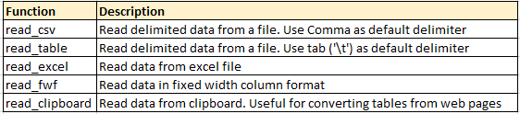
How to load data file(s)?
Input data sets can be in various formats (.XLS, .TXT, .CSV, JSON ).

Slide 45
Load data file from csv & excel
#Import Library Pandas
import pandas as pd
#Reading the dataset in a dataframe using Pandas print
df = pd.read_csv("E:/train.csv") # Load csv file
df=pd.read_excel("E:/EMP.xlsx", "Data") # Load Data sheet of excel file
df.head(3) #Print first three observations

Slide 46
How to convert a variable to different datatype
Converting a variable data type to other is important and common procedure we perform after loading data.
string_outcome = str(numeric_input) #Converts numeric_input to string_outcome
integer_outcome = int(string_input) #Converts string_input to integer_outcome
float_outcome = float(string_input) #Converts string_input to integer_outcome

Slide 47
How to convert character date to Date
from datetime import datetime
char_date = 'Apr 1 2015 1:20 PM' #creating example character date
date_obj = datetime.strptime(char_date, '%b %d %Y %I:%M%p')
print (date_obj)

Slide 48
How to transpose a Data set?
To transpose Table A into Table B on variable Product. This task can be accomplished by using dataframe.pivot.
# Load Data sheet of excel file EMP
df = pd.read_excel("E:/transpose.xlsx", "Sheet1")
print (df )
result = df.pivot(index= 'ID', columns='Product', values='Sales')
print(result)

